Slide 1
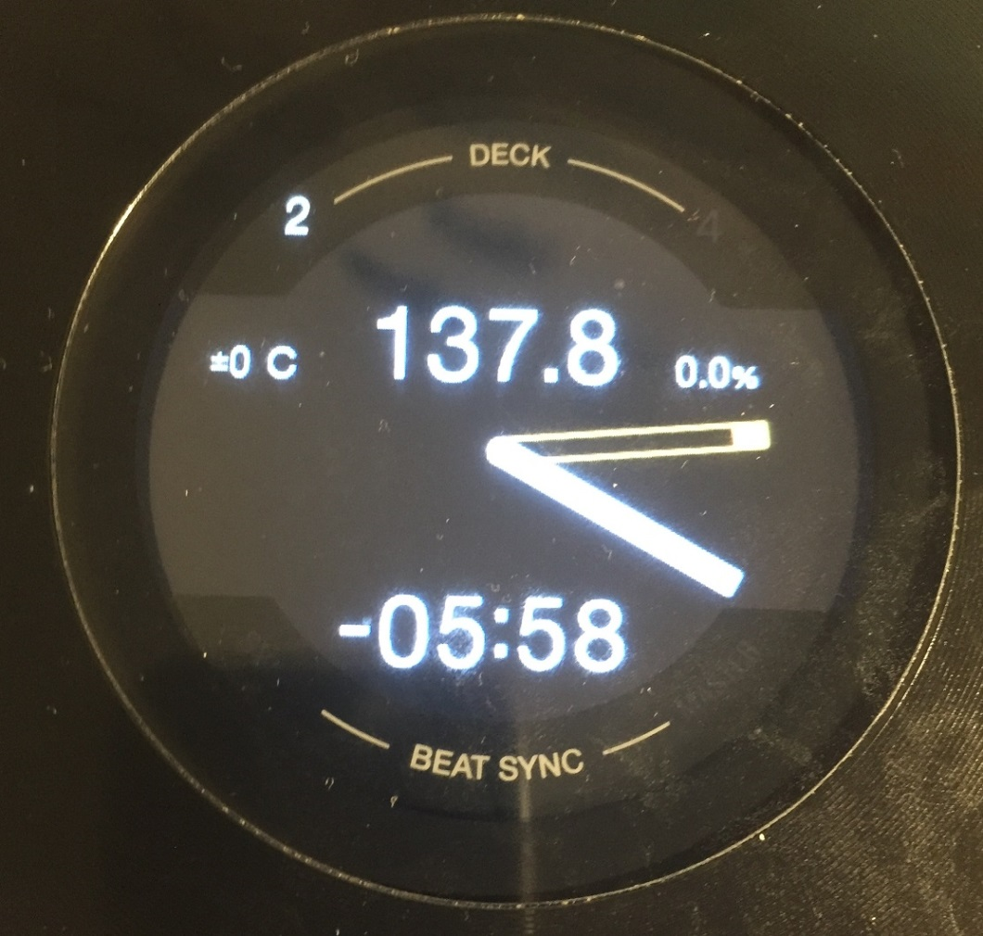
DDJ-1000: Jog Screens #1
Current BPM / Base BPM
Current Tempo / Tempo range
Key Variation / Key
CUE Needle
Time Elapsed / Remain Loop / BeatJump Size
Play Needle
Sync
Master

Slide 2
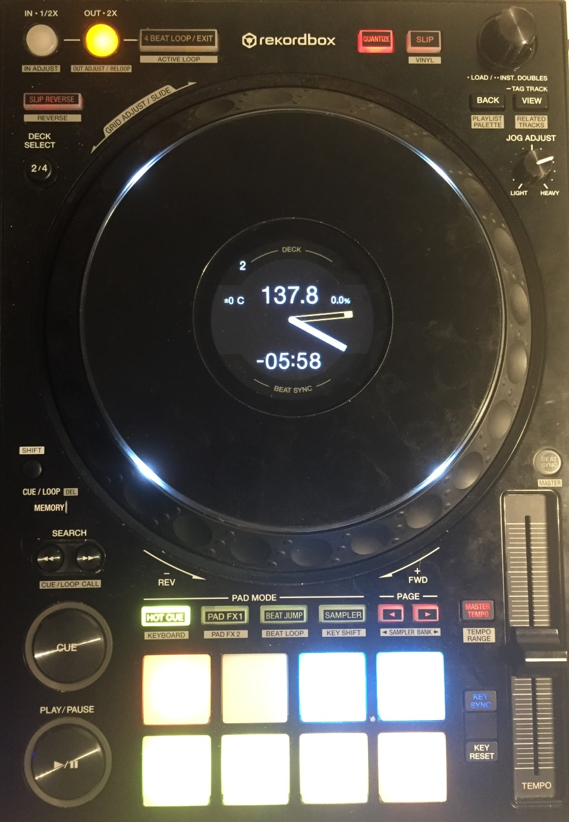
DDJ-1000: Jog Screens #2
RESET SCREENS
Show Loop size / Show BeatJump Size
Vinyl On/Off
On-Air Deck /
JogFX enabled
Show Tempo Range, Base BPM, Loop sizes
Toggle Time Elapsed & Remain
Tempo Range / Toggle Time Elapsed & Remain
Tempo adjust

Slide 3
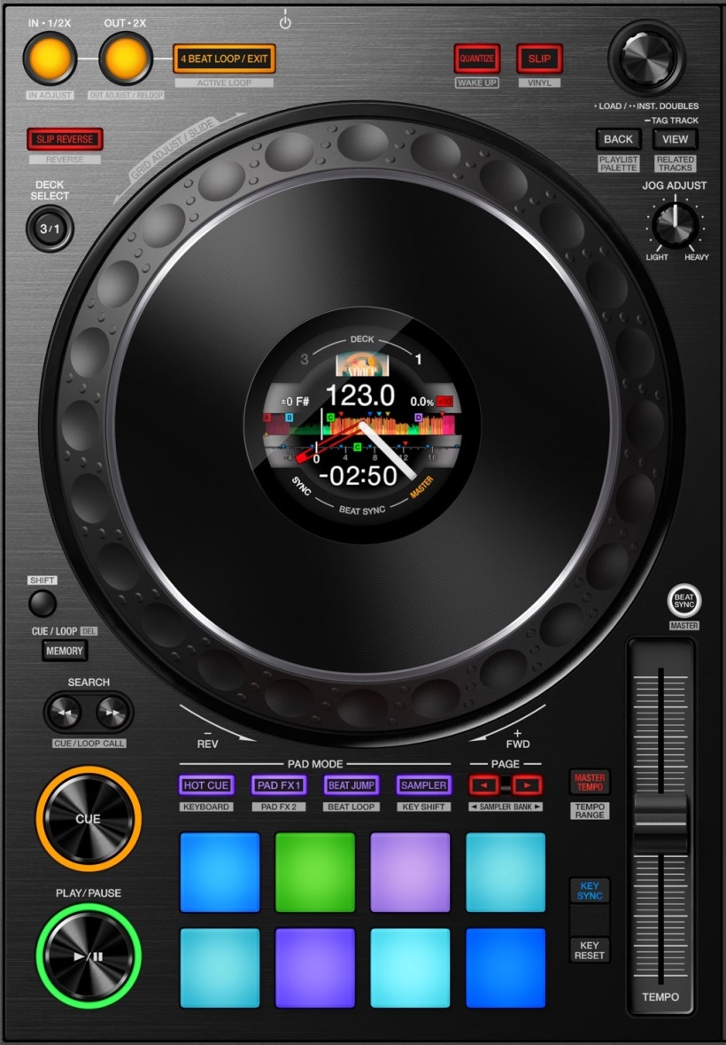
DDJ-1000: General overview #1
Quantize + Snap (toggle)
CDJ mode (shared 4 decks)
4-beat Loop / Active Loop / Move 1-beat
List Browse / Tree Browse Zoom / Preview player
LoopSize / MoveSize / BeatJump
Only Browser (toggle)
TP3 Slip Reverse
Preview Player
(using browser)
Layout change
JogFX / Quick Search
CDJ / Grid Adjust
Main shift
Second shift
Sync Toggle / Sync Off / Master
Not used
Track begin
Keylock / 6%->10%->16%->100%
Vinyl Stop / Release FX
BPM Slide / Set Marker / Auto
BPM Adjust / Reset Marker / Lock

Slide 4
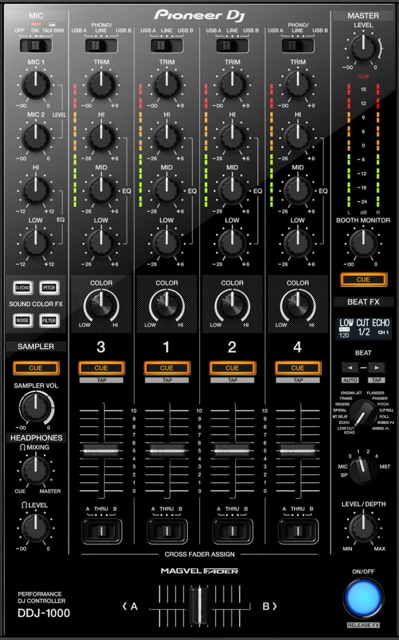
DDJ-1000: General overview #2
MixerFX2
MixerFX1+5
MixerFX3
MacroFX / MixerFX
Filter
FX Parameter / Single+Group
UserFX / Pioneer FX (in master mode)
JogFX+MacroFX DryWet
FX Routing
Dry Wet /
FX Parameter
FX ON+OFF

Slide 5
DDJ-1000: Pad modes
Each mode has several sub-pages. Per mode:
Press “mode” to cycle the top 2 pages
Press “<” to cycle all pages one by one
Press “>” to select a specific page
Jog FX
Macro FX (twice=cycle)
Pad FX (twice=cycle)
Cycle all pages
Hot Cues / Cancel JogFX
Select specific page
Keyboard mode
Remix decks
Slicer

Slide 6

DDJ-1000: Details
regular: Browse List
+shift: Browse Tree
+Memory: Zoom
+Back: Preview seek
press: Load
+shift: Open folder
+memory: Auto-zoom
Main shift
Second shift
Load Preview player
Only browser
regular: Cue
+shift: Move to font
regular: 4-Loop
+shift: Selected Loop
+memory: 1-Move
+memory +shift: Activate
regular: LoopSize
+shift: MoveSize
+memory: BeatJump
+memory +shift: IN/OUT
regular: Pause
+shift: Vinyl quick stop
+memory: Vinyl long stop
regular: Sync Force
+shift: Sync Off
+memory: Master
+shift: BPM set
+Jog: grid slide
+KeyReset: BPM Auto
+shift: BPM delete
+Jog: grid adjust
+KeySync: Analysis Lock

Slide 7
DDJ-1000: Macro+mixerFX and UserFX
Regular: FX Parameter
+shift: Single Group
MacroFX / Mixer FX
MixerFX2
UserFX Pioneer effects (MST)
Regular:MixerFX1
+shift:MixerFX5
MixerFX3
FX Routing
Filter
JogFX+MacroFX DryWet
Regular: DryWet
+shift: FX Parameter
MacroFX (twice=cycle)
FX ON+OFF

Slide 8

DDJ-1000: JogFX
Jog FX
Jog FX
Beatmasher / Digital filter / Gater
Beatmasher / Filter / Reverb
Event Horizon / Gater
Gater / Beatmasher / Reverb
Flanger / Gater
Beatmasher / Peak filter / Gater
FormatFilter / Peak filter / Flightest

Slide 9
DDJ-1000: MacroFX
Cycle all pages
MacroFX (twice=cycle)
Select specific page
MacroFX / Mixer FX
MixerFX2
Regular:MixerFX1
+shift:MixerFX5
MacroFX: WormHole
MacroFX: PolarWind
MacroFX: FlightTest
MacroFX: LaserSlicer
MixerFX3
Filter
BeatFX: Delay T3
BeatFX: Flanger
BeatFX: Reverb
Toggle On/OFF
Event Horizon
MacroFX: Zzzuurp
Dark
Matter
Bass-O-Matic
MixerFX: Flanger
MixerFX: TimeGater
MixerFX: Noise
MixerFX: Crush
Strrretch (Slow)
Strrretch (Fast)
Granu Phase
Toggle On/OFF
Filter

Slide 10
DDJ-1000: PadFX
PadFX
(twice=cycle)
Cycle all pages
Select specific page
Roll ‘’1/8 (Q)
Roll ‘’1/4 (Q)
Roll ‘’1/2 (Q)
Roll ‘’1 (Q)
Gater #1
Gater #2
Gater #3
Peak Filter
Roll ‘’1/8 (NQ)
Roll ‘’1/4 (NQ)
Roll ‘’1/2 (NQ)
Roll ‘’1 (NQ)
Beat
Masher #1
Beat
Masher #2
Zzzurp
Release FX (toggle)
Delay #1
Delay #1
Delay / BeatSlicer
Flanger Flux
Filter Pulse
LaserSlicer
Bass-O-Matic #1
Bass-O-Matic #2
Lofi / Slicer #1
Lofi / Slicer #2
BeatSlicer
Release FX (toggle)
Bouncer / EventH
Bouncer
EventH
Release FX (toggle)

Slide 11
DDJ-1000: Keyboard
+shift: keyboard mode
Down page
Up page
Key +4
Key +5
Key +6
Key +7
Key +12
Key 0
Key Inc
Key Dec
Key 0
Key +1
Key +2
Key +3
Key +8
Key +9
Key +10
Key +11

